Slide 1
The M@INLINE Project
Peter Sander & Co

Slide 2

M@INLINE
Multimedia
Applications
Involving
Non
Linear
Information for
Networked
Education
e-learning
e-nseignement
(in French)

Slide 3
Context
Started up Feb. 2000
Affiliated with
  I3S
    Informatics, Signals, and Systems in Sophia-Antipolis
    CNRS UMR6070
  ESSI
    Information Technology Engineering School
    University of Nice – Sophia-Antipolis

Slide 4
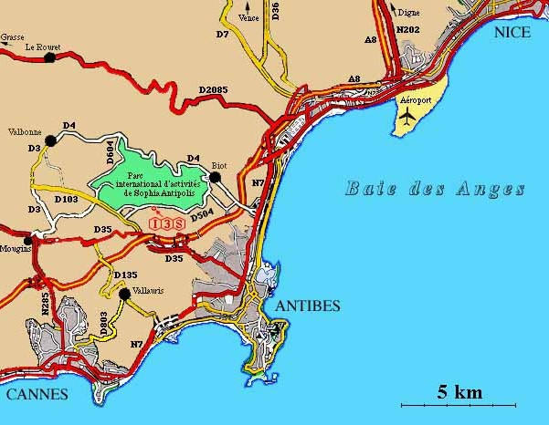
Location, Location, Location

Slide 5
The Group
Members
  Michel Buffa
  Marc Gaëtano
  Stéphane Lavirotte
  Peter Sander
  Jean-Paul Stromboni
  Jean-Yves Tigli
Associates
  Dominique Broeglin
  Stéphane Dalmas
  Catherine Faron
  Jean-Marc Fédou

Slide 6
Interests
Distance Learning
Interactive documents
Visualization

Slide 7
Activities
Live mathematics
  JOME (Java OpenMath Editor)
Courseware
  Platform
    XCC, XIND
  Infrastructure
    EIS
  Content
    On-line courses

Slide 8
Projects
OpenMath
OpenMath Thematic Network
Trial-Solution
EML
TICE
E-MIAGE

Slide 9
The INRIA Connection
University
of Nice
INRIA
M@INLINE
CAFE
Marc Gaëtano
Stéphane Dalmas

Slide 10
CAFE
Computer
Algebra
Functional
Equations
Algorithms for differential and difference equations
Formula databases

Slide 11
Context
Started up 1998
Following up SAFIR project
Affiliated with
  INRIA
    National Research Institute for Computer Science and Control
  I3S
    Informatics, Signals, and Systems in Sophia-Antipolis
    CNRS UMR6070
    M@INLINE

Slide 12
Location, Location, Location
Two minutes walking distance from M@INLINE ☺

Slide 13
The Group
Members
  Manuel Bronstein
  Stéphane Dalmas
  Evelyne Hubert
  Alban Quadrat
Associates
  Marc Gaëtano
  Jacques Arthur Weil

Slide 14
Interest
Computer Algebra
Ordinary Differential Equations
Software tools for mathematics

Slide 15
Activities
Theory
  Linear ordinary differential equations
  Nonlinear differential systems
Algorithms, Implementations
  Salli
  Sum^it
Software tools
  OpenMath libraries
  MathML
  Formula Database

Slide 16
Projects
OpenMath
OpenMath Thematic Network
Cathode

